Slide 1
FIA Code Refresher and Practice Note Update
7 December 2022

Slide 2
Topics Covered
The FIA Code
Practice Notes
Digital Fundraising
Younger People and Fundraising
Fundraising & Reporting During Natural Disasters

Slide 3
The FIA Code
Importance of the FIA Code:
To support and protect fundraisers
To protect communities where we fundraise
To advance excellence in professional fundraising

Slide 4
The FIA Code
Ethical standards in conduct & practice
To build and maintain TRUST with donors and the public

Slide 5
Risks of Unethical Fundraising
Fades trust and confidence of donors and the community
Impacts charitable causes adversely
Could trigger stricter regulations from the government

Slide 6
Scope of the FIA Code
Self-regulatory and does not replace or override any relevant law
Adherence to the Code is a requirement of FIA Membership
FIA Code Authority monitors compliance of FIA Members
Contains 7 main clauses with several sub-clauses (ethical conduct, conduct towards donors, beneficiaries, and in supplier relationship)
FIA Code clause 3.1 – Members will not engage in activities that bring Fundraising into disrepute
FIA Code Training

Slide 7
FIA Code Practice Notes
Assist FIA Members with guidance for conduct and best practice across specific areas of fundraising
Acceptance & Refusal
Applying the Code: Professional vs. Organisations
Charitable Gaming Fundraising
Code Training Requirements
Complaint Handling by charities and not-for-profits
Digital Fundraising
Events Fundraising
Face to Face Fundraising
Fundraising and Natural Disasters
Fundraising and Younger People
Fundraising Supply Chain Governance
Fundraising Supplier Relationships
Gifts in Wills & Bequests
Grants Fundraising
In-Person Fundraising Post-COVID
Managing Communication Preferences in Fundraising
Overseas Aid Fundraising
People in Vulnerable Circumstances including Postcard
Promotional Materials
SMS and MMS
Telephone Fundraising
Workplace Giving
Notes:
Consultation

Slide 8
Digital Fundraising Practice Note
Raising and appealing for funds online through technology enabled means
Developed to assist FIA Members in complying with the FIA Code when conducting digital fundraising
Notes:
E.g, social media, organisational websites, mobile phone apps, sms, email, crowdfunding, donation websites, etc

Slide 9
Digital Fundraising Practice Note
Avoiding Misrepresentation & Maintaining Transparency
See Clause 4.11 FIA Code (promotional materials)
Practices to Avoid (Clauses 1 & 2 Digital Fundraising Practice Note)
Using emotive language or images
Misrepresenting the true purpose of a fundraising activity
Failing to disclose important information for informed decision making
Making inaccurate statements about the specific Cause for which funds are being raised

Slide 10
Digital Fundraising Practice Note
Respecting Donor Preference
See Clause 4.2 of the FIA Code: Members will, each time they contact a prospective Donor, provide information about how the prospective Donor can opt-out of receiving any further solicitations from the Member
See Clause 3 Digital Fundraising Practice Note
Option to decline all communication/digital content and unsubscribe should be readily available and easy to choose

Slide 11
Digital Fundraising Practice Note
Keywords and Intellectual Property
Keyword bidding or search engine advertising enables you to place your ad at the top of the results page when someone searches for a keyword
Clause 4.11(a) FIA Code states: Members will ensure their promotional materials are not false, misleading or likely to deceive.

Slide 12
Digital Fundraising Practice Note
Keywords
Member’s that bid on another charitable organisations keyword(s) should ensure their landing page is clear about their identity and the cause they represent
Bidding on another charitable organisations name or keyword(s) normally associated with that organisation (either intentionally or unintentionally) may confuse donors into supporting the wrong cause
See Clauses 9.2 & 9.3 DFPN

Slide 13
Digital Fundraising Practice Note
Intellectual Property
Clause 4.11(f) FIA Code: Members will ensure that their promotional materials do not infringe on the intellectual property rights of others.
Digital marketing content should reflect your original work or have a substantial amount of originality to it
Consent or license for using third-party material should be sought and obtained
See Clauses 9.4-9.6 DFPN
Notes:
- Avoid ad copy that infringes on the copyright, trademarks, design and other IP of another charity which may mislead donors about the benefiting charity or Cause.

Slide 14
Younger People and Fundraising Practice Note
Developed to assist FIA members in dealing appropriately with younger people both as fundraisers and as donors
Principles that apply when dealing with vulnerable donors should be employed when dealing with younger people

Slide 15
Younger People and Fundraising Practice Note
A younger person may participate in fundraising by:
giving to a cause without being solicited for a donation
making a donation after being solicited
being engaged as a fundraiser
See Clause 1.4 Younger People and Fundraising Practice Note
Notes:
The FIA Code defines a child as a person under the age of 18 years

Slide 16
Younger People and Fundraising Practice Note
Accepting a Donation from a Younger Person without Soliciting
The Code in clause 4.7(a): Members will not accept a donation where they have reasonable belief that the donor is in vulnerable circumstances or lacks capacity to make a decision to donate
Increased likelihood to lack the capacity to consent
Identify the decision-making capacity of a young person donating and establish that the young person is not being exploited.
If there is reason to believe that a younger person may lack the capacity to consent and to make an informed decision request for the presence of a parent or guardian

Slide 17
Younger People and Fundraising Practice Note
Soliciting a Donation from a Younger Person
The Code in clause 4.11(c): Members will ensure their promotional materials are not knowingly sent to a Child without the consent of the Child’s parent or guardian
Members are prohibited from intentionally soliciting donations from any person that is below the age of 18 or appears to be below the age of 18, unless with the knowledge of a parent or guardian.

Slide 18
Younger People and Fundraising Practice Note
Younger People as Fundraisers
Need for extra protections when engaging younger people as fundraisers
The supervision of any younger person engaged as a fundraiser is the responsibility of Members
Develop and maintain risk management strategies
State-based regulatory requirements (see Practice Note)
Fundraising regimes (Charitable Fundraising laws), and child employment and/or child education laws of that State or Territory

Slide 19
Younger People and Fundraising Practice Note
Scope of the Regulatory Requirements that may be Applicable when Engaging a Younger Person as a Fundraiser
the minimum age requirement for a person to participate as a fundraiser or in a collection in that State or Territory
the minimum employment age in that State or Territory including employment requirements
their supervisory obligations when engaging a younger person as a fundraiser in that State or Territory
the consent requirements from a parent or guardian in that State or Territory
the working hours restrictions in that State or Territory
the working with children requirement in that State or Territory

Slide 20
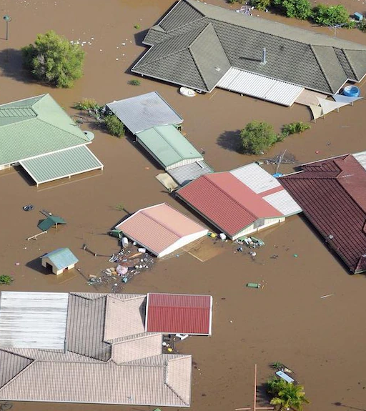
Fundraising and Reporting During Natural Disasters
Developed to improve accountability to donors and the wider public whenever fundraising for natural disasters, through a framework for transparent fundraising and public reporting
Notes:
Adverse public scrutiny on the timeliness of the distribution of donated funds

Slide 21
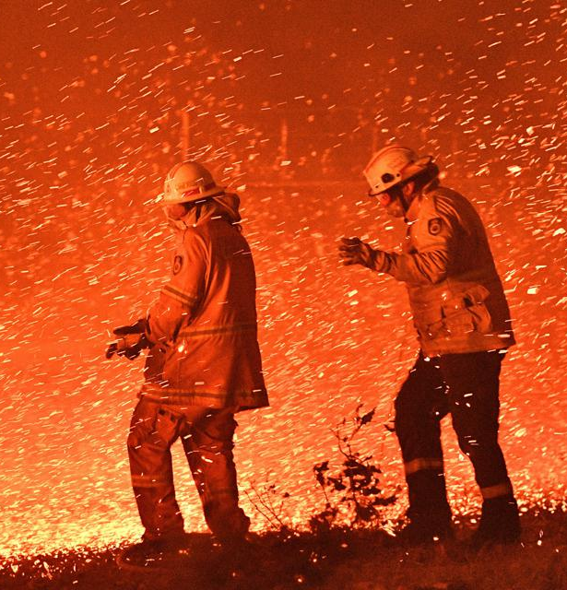
Fundraising and Reporting During Natural Disasters
Accountability
Appeal Intent
Accuracy of Appeal Intent and Reporting
Reporting Use of Donations
Frequency of Reporting
Template for Reporting

Slide 22
Questions

Slide 23
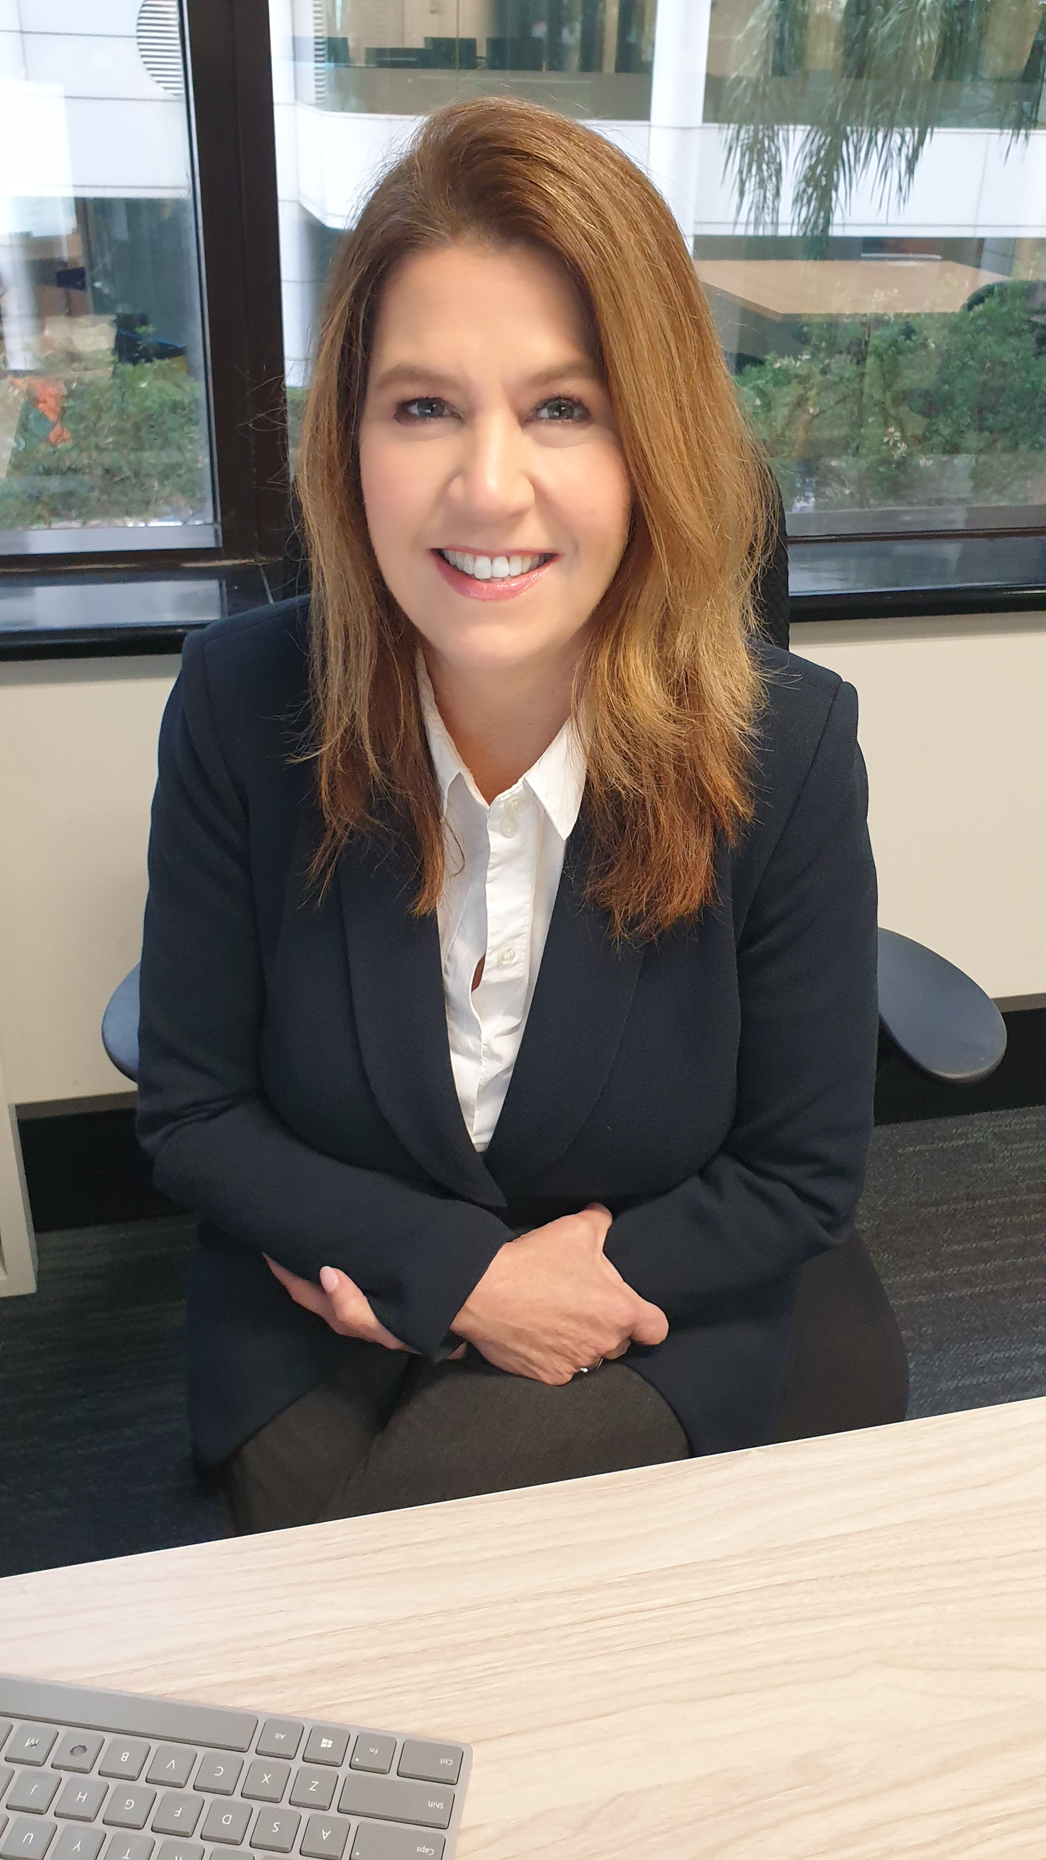
Thank you!
Katherine Raskob, MIM, GAICD
Chief Executive Officer
kraskob@fia.org.au
Jonathan Ande, LLM, PhD
Policy Advisor
jande@fia.org.au

